Slide 1
Secondary Transition & CTE Spring Network
Lydia Brodegard, Scott Eldredge & Sherri Lawrence
March 3, 2023
9 am - 11 am
https://zoom.us/s/98351672477
Notes:
Join Zoom Meeting
https://zoom.us/s/98351672477

Slide 2
Welcome
Notes:
link to resources: https://tinyurl.com/msfnpx6t
Welcome participants.
Introduce SST staff.
Review shared folder and drop link.

Slide 3
Today’s Objectives
Provide guidance and resources to support secondary transition.
Review federal and state updates pertaining to secondary transition and SSIP.
Explore areas of need for the region and plan for collaboration, networking & professional learning.
Address questions about secondary transition and CTE pathways.

Slide 4
Agenda
Welcome
Updates ODE/OEC, ESC, OOD, and Board of Developmental Disability partners
Introduce Recruiting Special Populations Toolkit
District share: Claymont City Schools
Guest share: Jeff Berk
Wrap up & Next Steps

Slide 5
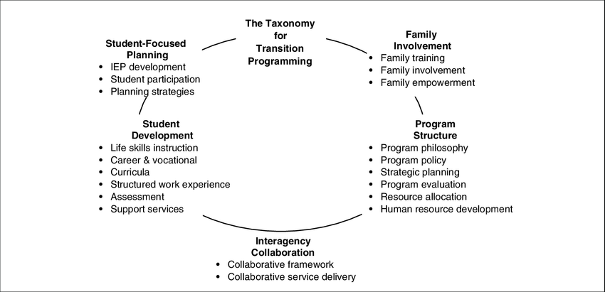
Check point for Taxonomy for Transition Programming
Notes:
Lydia

Slide 6
ODE/OEC Updates
Unlock Your Future
Indicator 14 Exiting Student Data Collection
Ohio Accessibility Manual, 8th Ed.
WebXam
WebXam-Users Guide
WebXam Text to Speech
WebXam Pretests/Practice Tests
Notes:
Updates
OOD share out
DD share out

Slide 7
ESC Partner Updates
Notes:
Lydia will introduce ESC special education director, guests.
MVESC to present on industry recognized credentials and opportunities - Justin Denius

Slide 8
Interagency Collaboration
Travis Stewart
OOD Vocational Rehabilitation Supervisor
Autumn Dent Emily Cucaita Rachel Geary Sean Ragsdale
OOD Vocational Rehab Counselors
Notes:
Lydia

Slide 9
Board of Developmental Disabilities
Jefferson
Monroe
Muskingum
Perry
Tusc
Belmont
Carroll
Coshocton
Guernsey
Harrison
Holmes
Notes:
Lydia
*followup email sent to all Board of DD directors and spec ed directors that Cheryl had on file.

Slide 10
Recruiting Special Populations into Career Technical Education
Key Findings in CTE Research
• Students experiencing homelessness who participated in at least three CTE courses had higher graduation rates and lower dropout rates compared to students experiencing homelessness participating in less than three CTE courses (Advance CTE and National Center for Homeless Education, 2020).
• According to Ohio’s Education Management Information System (EMIS) data, Ohio foster care students who were CTE concentrators who left school in 2021 for whom status is known, 88.6% were employed within six months of leaving school.
• For Ohio’s students receiving special education services, completing at least three semesters of CTE coursework in the same career pathway or concentration increases the likelihood of post-school employment (Unger et al., 2021).
Notes:
Sherri

Slide 11
Strategy 1: CTE Recruitment-
Reflection and Action Planning
• Do I know what special population groups are in my district?
• Do I know which special population groups in my district are most commonly participating in which CTE programs?
• Are special populations enrolled in CTE at rates similar to how they show up in the district overall?
• What CTE programs align to in-demand careers in the area?
Notes:
Sherri

Slide 12
Strategy 2:
Leveraging Partnerships for Inclusion
Reflection and Action Planning:
• Do I know what other partners are serving my district’s special population groups?
• Am I leveraging partnerships to better reach and/or serve my district’s special populations?
Notes:
Sherri

Slide 13
Strategy 3:
Removing Barriers to Access
Reflection and Action Planning:
• How does my district or program review and reflect on existing policies with a lens for equity?
• How does my CTE program inform parents, teachers, and students about CTE opportunities and outcomes?
• Do my program’s marketing materials and practices emphasize inclusivity and successful outcomes?
Notes:
Sherri

Slide 14
District Share Out:
Transition Roadmap
Notes:
Sherri Intro Claymont?

Slide 17
Webinar Slides from NRF Webinar 11/23/22
Notes:
Break out room
Next Steps: https://docs.google.com/document/d/1pFatZQ_u08Kri9bPk1CR439hHJeblHSXhbTHYaAKvgs/edit?usp=sharing

Slide 18
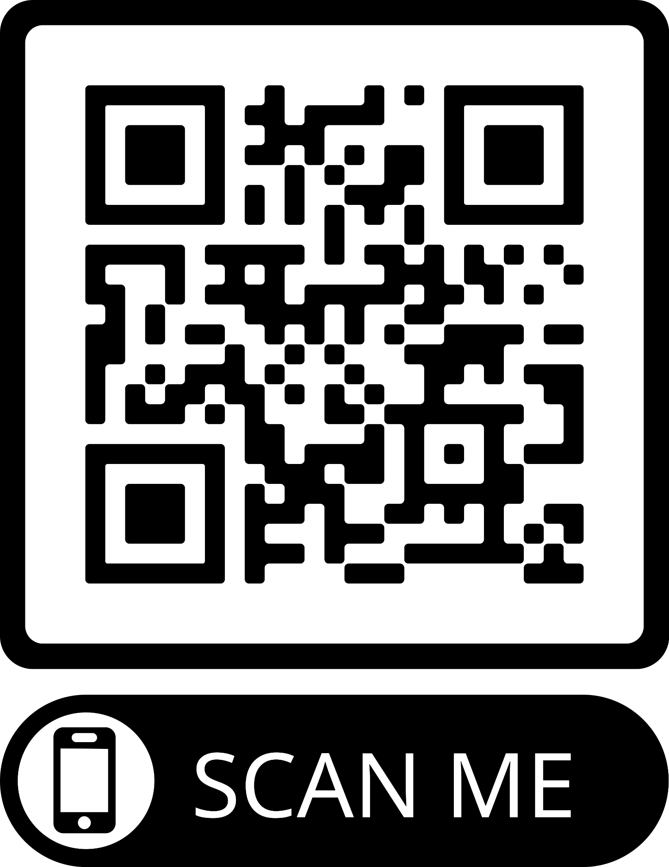
Please complete an evaluation for today’s network and help us plan for …
Notes:
Drop the link in the chat:
Certificate for Zoom AM Only: https://docs.google.com/presentation/d/1jzNI-fxEV_sbQcjP6af7Vd1iMfUSWQZ080IEjf3b3aQ/edit?usp=sharing
Evaluation for Zoom: https://forms.gle/6sRSSm9XFg5KxzZi9

Slide 20
Contacts
Lydia Brodegard lydia.brodegard@sstregion12org
Scott Eldredge scott.eldredge@sstregion12.org
Sherri Lawrence sherri.lawrence@sstregion12.org

